Slide 1
Review of Basic Python
CSE 2050
Ahmad Jbara
University of Connecticut

Slide 2
What is Python?
It's a programming language.
Easy to learn.
Easy to use.
Lots of features.
It has a powerful set of built-in data types.
It is an interpreted language.
It is dynamically typed.
Free!

Slide 3
Tutorial
This is one of the resources you will use this semester.
https://docs.python.org/3/tutorial/index.html
We will use Python 3 in this course.

Slide 4
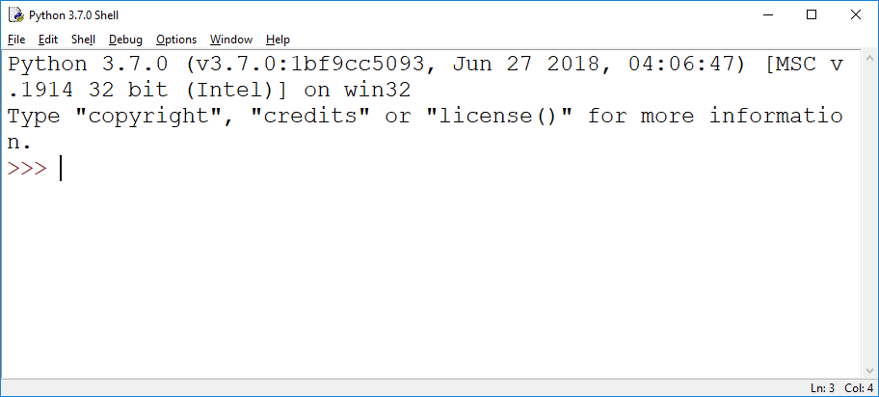
Starting Python

Slide 5
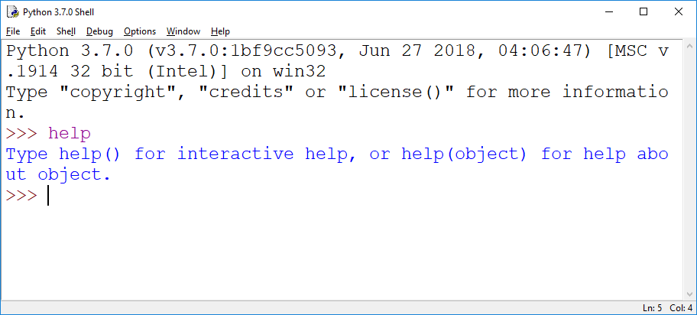
Built-in help

Slide 6
Online tutorial
https://docs.python.org/3/tutorial/index.html
I recommend reading section 1 and section 3.
Type examples as you read them.

Slide 7
The Python working modes
Interactive mode
A command line shell that gives immediate feedback.
Good to learn and practice.
Script mode
Finished program (.py file) is run.

Slide 8
The Python command line
You type something, and it tells you the result.
>>> you type something here
it shows you the result here

Slide 9
Expressions and evaluation
Expressions are evaluated and produce value.
Arithmetic expressions yield numerical values.
1 + 1, 4 * 3, 7 % 2 (modulus) , 7 // 2 , 2 ** 3
Relational expressions yield boolean values.
5 > 2, 3 == 4,
Logical expressions yield boolean values.
5 < 2 and 3 == 3 (lazy evaluation)
Operator precedence is important!

Slide 10
Numbers
>>> 2 + 2
4
>>> 50 - 5*6
20
>>> (50 - 5*6) / 4
5.0
>>> 8 / 5 # division always returns a floating point number
1.6

Slide 11
Variables and Types
A variable is just a name.
It is associated with some data (object).
It is created by an assignment statement (=).
variable = some value
The variable name is and expression that is evaluated to its object

Slide 12
Variables and Types
a
b
>>> a = 5
>>> a
5
>>> a = 10
>>> a
10
>>> b = a + 3
>>> a * b
130
10
13

Slide 13
Variables and Types
Every object has a type (class?).
Atomic types: integers, floats, and booleans.
Use the type() function to know the type.

Slide 14
Variables and Types
Every object has a type (class?).
Atomic types: integers, floats, and booleans.
Use the type() function to know the type.
Every object has: identity (id() function), type, and value.
Mutable vs. immutable objects.

Slide 15
Collections
Each of the following types can store a collection of things…
Strings
Lists
Tuples
Dictionaries
Sets

Slide 16
Strings
String is a sequence of characters.
s = “Hello ”
t = ‘World’
The name of the type (class) is str.
print(type(s))
String concatenation (new string is created)
u = s + t

Slide 17
Strings
Accessing a single character using [] and index.
print(s[0])
String is immutable.
s[0] = ‘h’ will raise an exception
You can convert other objects into strings.
v = str(543)
print(type(v))
Membership testing is done using the (not) in operator
‘e’ in s will print True

Slide 18
Strings
Removing whitespaces from the beginning and the end
s.strip() will return a new string
Split a string into a list
s = “This is a string”
s.split() will produce [“This”, “is”, “a”, “string”]
Join list items into a string
L = [“This”, “is”, “a”, “string”]
“ “.join(L) will produce “This is a string”

Slide 19
Lists
List is a sequence of objects (can be different).
L = [ “Hello”, 3, 2.9, “world”]
The name of the type (class) is list.
print(type(L))
You can access a single element using [] and index
print(L[2])
You can change the value of an element
L[1] = 5

Slide 20
Lists
You can append element to the end
L.append(14)
You can remove the last element of the list
print(L.pop())
Membership testing is done using the (not) in operator
print( 14 in L) will print True

Slide 21
Lists
To remove an element use
L.remove(14)
Use the + operator for concatenation
L1 = [1, 2, 3]
L2 = [4, 5, 6]
L3 = L1 + L2

Slide 22
Tuples
A tuple is a sequence of objects (can be different).
L = (“Hello”, 3, 2.9, “world”)
The name of the type (class) is tuple.
print(type(L))
You can access a single element using [] and index
print(L[2])
You cannot append element to the end (tuple is immutable)
L.append(14) will raise an exception

Slide 23
Tuples
You can concatenate tuples using +
t1 = (1, 2, 3)
t2 = (4, 5, 6)
t3 = t1 + t2
Membership testing is done using (not) in
2 in t1 will return True

Slide 24
Dictionaries
A dictionary stores key – value pairs.
Every element (key-value pair) has two parts: key and value.
d = {1:”one”, 2:”two”, 3:”three”}
The keys are immutable types.
If you have the key you can get the value
print(d[2]) 2 is not an index, it is a key.
Dictionaries do not have a fixed order for their elements.

Slide 25
Sets
A set is a collection of objects without duplicates and has no fixed order.
S = {2, 3}
The name of the type is set.
print(type(S))
You can use the add() function to add a new element
S.add(1)
S.add(2) this line has no effect
You cannot access elements using []. A set does not support indexing.
Remove items using remove
S.remove(2)

Slide 26
Common operations on collections
Finding the number of elements in a collection
a = “string”
print(len(a))
Slicing a subsequence (string, list, tuple)
print(a[1:4]) will produce “tri”
Iterating over a collection
for item in collection/range:
do something

Slide 27
Names, variables, and assignment
A = [1, 2, 3]
B = A
print(id(A), id(B))
B[1] = 20
A[1] == 20
B = [4, 5, 6]
A = “Hello”
print(id(A), id(B))

Slide 28
Names, variables, and assignment
L = [1, 2, 3]
M = [L , L + L]
L[0] = 0
print(M)

Slide 29
Modifying a list
L = [1, 2, 3]
1) for item in L
item = item * 2
2) for i in range(len(L)):
L[i] = L[i] * 2
3) newL = []
for item in L:
newL.append(item*2)
4) newL = [item *2 for item in L]

Slide 30
Forms of control flow
if x < 5:
print(“less than 5”)
else:
x = x -1
print(x)

Slide 31
Forms of control flow
x = 0
while x < 10:
print(x)
x = x + 1
print(x)
for x in range(10):
print(x)

Slide 32
Forms of control flow
x = 0
L = [4, 7, 8, 1]
while x < len(L):
print(L[x])
x = x + 1
for x in range(len(L)):
print(L[x])
for x in L:
print(x)

Slide 33
Forms of control flow
try:
x = float(“12x”)
except ValueError:
print(“you can’t convert a string to float”)

Slide 34
Forms of control flow
def foo():
return 8 * x + y
print(foo(2,1))
print(foo(“Hello”, “world”))

Slide 35
Forms of control flow
def foo(x):
return x + 2
def bar(somefunction):
return somefunction(4)
print(bar(foo))
somevariable = foo
print(bar(somevariable))

